Slide 1


Kernels of Mallows Models for Solving Permutation-based Problems
Josu Ceberio, Alexander Mendiburu, Jose A. Lozano
Intelligent Systems Group
Department of Computer Science and Artificial Intelligence
University of the Basque Country UPV/EHU
Genetic and Evolutionary Computation Conference (GECCO 2015)
Madrid, Spain, 11-15 July 2015

Slide 2
Preliminaries

Slide 3
Permutation optimization problems
Combinatorial optimization problems

Slide 4
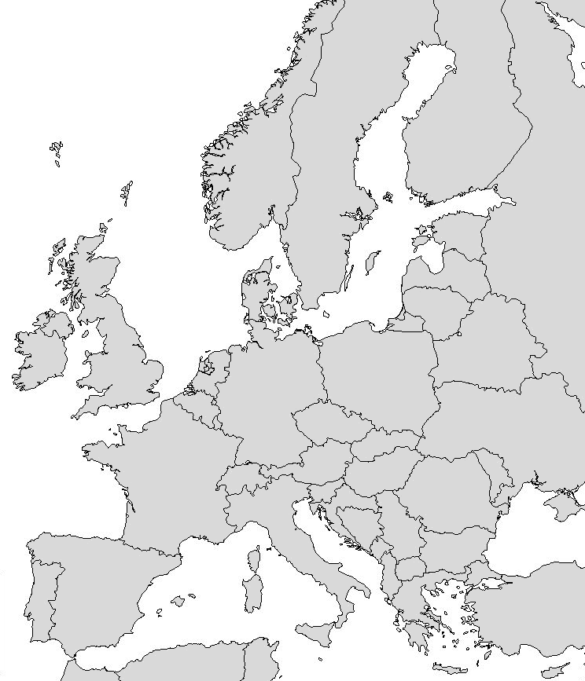
Permutation optimization problems
Travelling Salesman Problem (TSP)
Problems whose solutions are naturally represented
as permutations
8
7
6
3
5
2
4
1

Slide 5
Recently…
A new trend of Estimation of Distribution Algorithms for permutation problems have been proposed
EDAs quickly
Initialize population
While stopping criterion is not met
Selected most promising individuals
Learn a probability distribution
Sample new individuals from the distribution
Update the population
Return the best solution
Mallows

Slide 6
The Mallows model Definition
A distance-based exponential probability model
Central permutation
Spread parameter
A distance on permutations

Slide 7
The Mallows model Definition
A distance-based exponential probability model
Central permutation
Spread parameter
A distance on permutations

Slide 8
The Mallows model Definition
A distance-based exponential probability model
Central permutation
Spread parameter
A distance on permutations

Slide 9
The Mallows model Kendall’s-τ distance
Measures the number of pairwise disagreements between and .
1-2
1-3
1-4
1-5
2-3
2-4
2-5
3-4
3-5
4-5

Slide 10
The Mallows model Cayley distance
Measures the minimum number of swap operations to convert in .

Slide 11
The Mallows model Learning
Population
5 4 1 2 3
4 2 3 5 1
1 2 3 5 4
2 4 3 5 1
3 1 4 5 2
2 3 4 1 5
2 3 4 5 1
2 5 4 3 1
1 2 5 4 3
5 3 1 2 4
Calculate the central permutation
- Borda (Kendall’s-τ)
- Set median permutation (Cayley)
Estimate the spread parameter
- Newton-Raphson
11

Slide 12
The Mallows model Sampling
For both metrics, the distance between and can be decomposed as a sum of terms.
Factorized
distribution

Slide 13
Drawbacks
These models are unimodal
Often too restrictive
13

Slide 14
Drawbacks
What happens if good fitness solutions are far from each other?
Many works in the literature have proposed using mixtures of models
14

Slide 15
Drawbacks
What happens if good fitness solutions are far from each other?
Building mixture models implies costly algorithms
Many works in the literature have proposed using mixtures of models
15

Slide 16
The proposal: Kernels of Mallows models

Slide 17
Kernels of Mallows models
Population
5 4 1 2 3
4 2 3 5 1
1 2 3 5 4
2 4 3 5 1
3 1 4 5 2
2 3 4 1 5
2 3 4 5 1
2 5 4 3 1
1 2 5 4 3
5 3 1 2 4
17

Slide 18
Mallows Kernels EDA
There is no learning step
Initialize population with individuals
Initialize and
While stopping criterion is not met
Selected the most promising individuals
Define Mallows kernels from the selected individuals
Sample individuals from each kernel
Update population
Update
Return the best solution
Repeated solutions
are discarded
Exploration / Explotation trade-off
18

Slide 19
Experimental Study

Slide 20
The question
Can EDAs based on Kernels of Mallows Models outperform
Mallows EDA (MEDA) or Generalized Mallows EDA (GMEDA)?
20

Slide 21
Experimental Design
Algorithms:
Mallows EDA (M)
Generalized Mallows EDA (GM)
Mallows Kernel EDA (K)
Distances:
Kendall’s-τ
Cayley
Benchmark Problems:
Quadratic Assignment Problem (QAP)
Permutation Flowshop Scheduling Problem (PFSP)
21

Slide 22
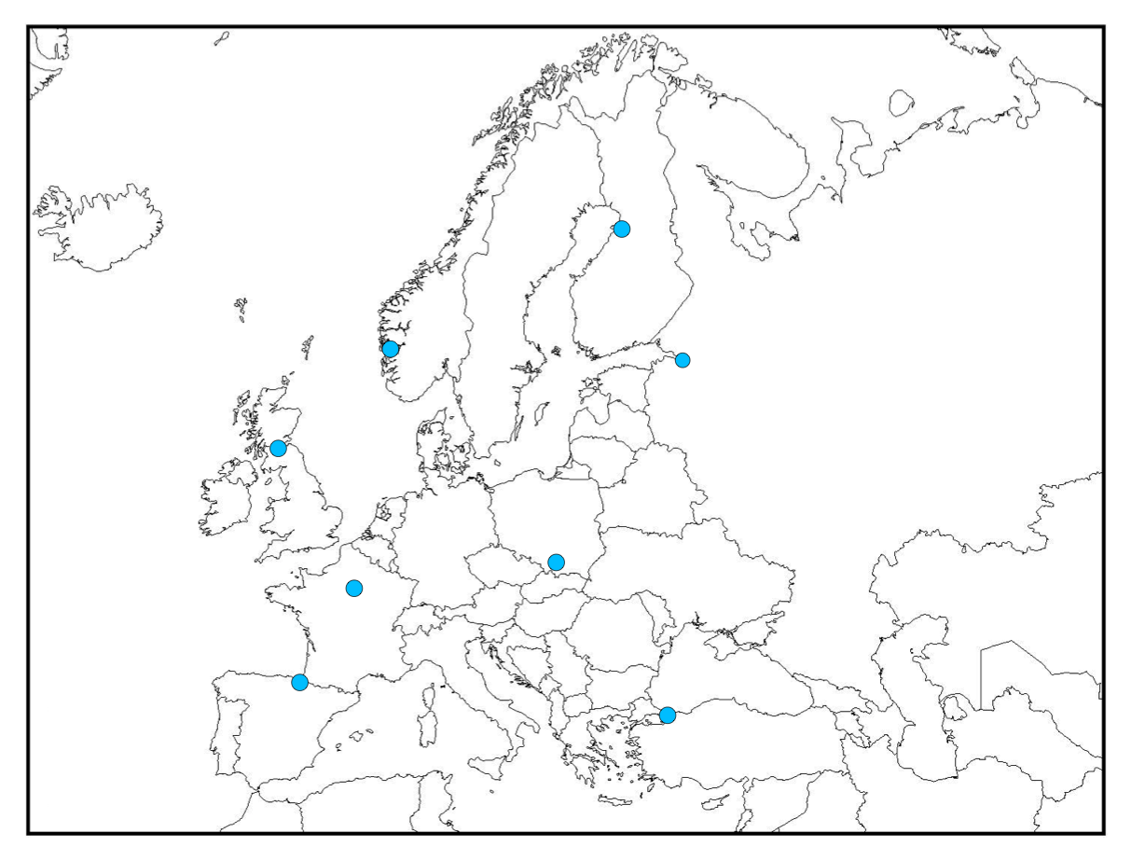

Experimental Design
The quadratic assignment problem (QAP)
8
1
7
2
6
3
2
4
5
5
6
3
7
1
8
4

Slide 23
Experimental Design The quadratic assignment problem (QAP)
8
1
7
2
6
3
2
4
5
5
6
3
7
1
8
4

Slide 24
Experimental Design Permutation Flowshop Scheduling Problem (PFSP)
Total flow time (TFT)
jobs
machines
processing times
5 x 4
j₁
j₂
j₃
j₄
j₅
m₁
m₂
m₃
m₄
24

Slide 25
Experimental Design Instances
45 Artificial QAP instances:
Size: 100, 150, 200, 250, 300, 350, 400, 450, 500
5 instances of each size
Sampling parameters from Taillard’s instances: tai80a ,tai80b, tai100a,…
45 Artificial PFSP instances:
Jobs: 50, 100, 200, 250, 300, 350, 400, 450, 500
Machines: 20
5 instances of each size
Sampling uniformly at random from [1,100]
25

Slide 26
Experimental Design
Parameter Settings:
Population size: 10n
Selected individuals: n
Selection type: truncation
and :
Sampled individuals: 10n-1
Stopping criterion: 1000n² evals
10 repetitions
26

Slide 27
Experimental Study ARPD Results

Slide 28
Experimental Study ARPD Results
Statistical Analysis
Two non-parametric Friedman tests (α=0.05)
QAP (6 algorithms):
PFSP (6 algorithms):
p-value < 0.001
p-value < 0.001

Slide 29
Experimental Study ARPD Results
Statistical Analysis
Two non-parametric Friedman tests (α=0.05)
QAP (6 algorithms):
PFSP (6 algorithms):
Shaffer’s static posthoc – pairwise comparisons
QAP:
PFSP:
p-value < 0.001
p-value < 0.001

Slide 30
Experimental Study Computational Cost (seconds)

Slide 31
Conclusions
Can EDAs based on Kernels of Mallows Models outperform
Mallows EDA (MEDA) and Generalized Mallows EDA (GMEDA)?
Yes, if they are defined under the Cayley distance
In fact, Kernels of Mallows models under the Cayley distance are the best option in terms of fitness and computational cost
31

Slide 32
Future Work
Short term
Understand why similar results are not obtained with Kendall’s-τ
Apply automatic (offline) algorithm configuration: Irace
Study more advanced strategies to adapt θs
Long term
Include other distances such as Ulam or Hamming
Apply to other permutation problems
32

Slide 33



Thank you for your attention!

